Slide 1
Comparative Analysis of Legal and Regulatory Frameworks for Resettlement in the Global Mining Industry Summary Presentation
Dr Vlado Vivoda
Associate Professor John Owen
Professor Deanna Kemp

Slide 2
Presentation outline
Introduction
Land tenure systems and national frameworks
Comparative review of national frameworks
Key findings
Acknowledgements

Slide 3
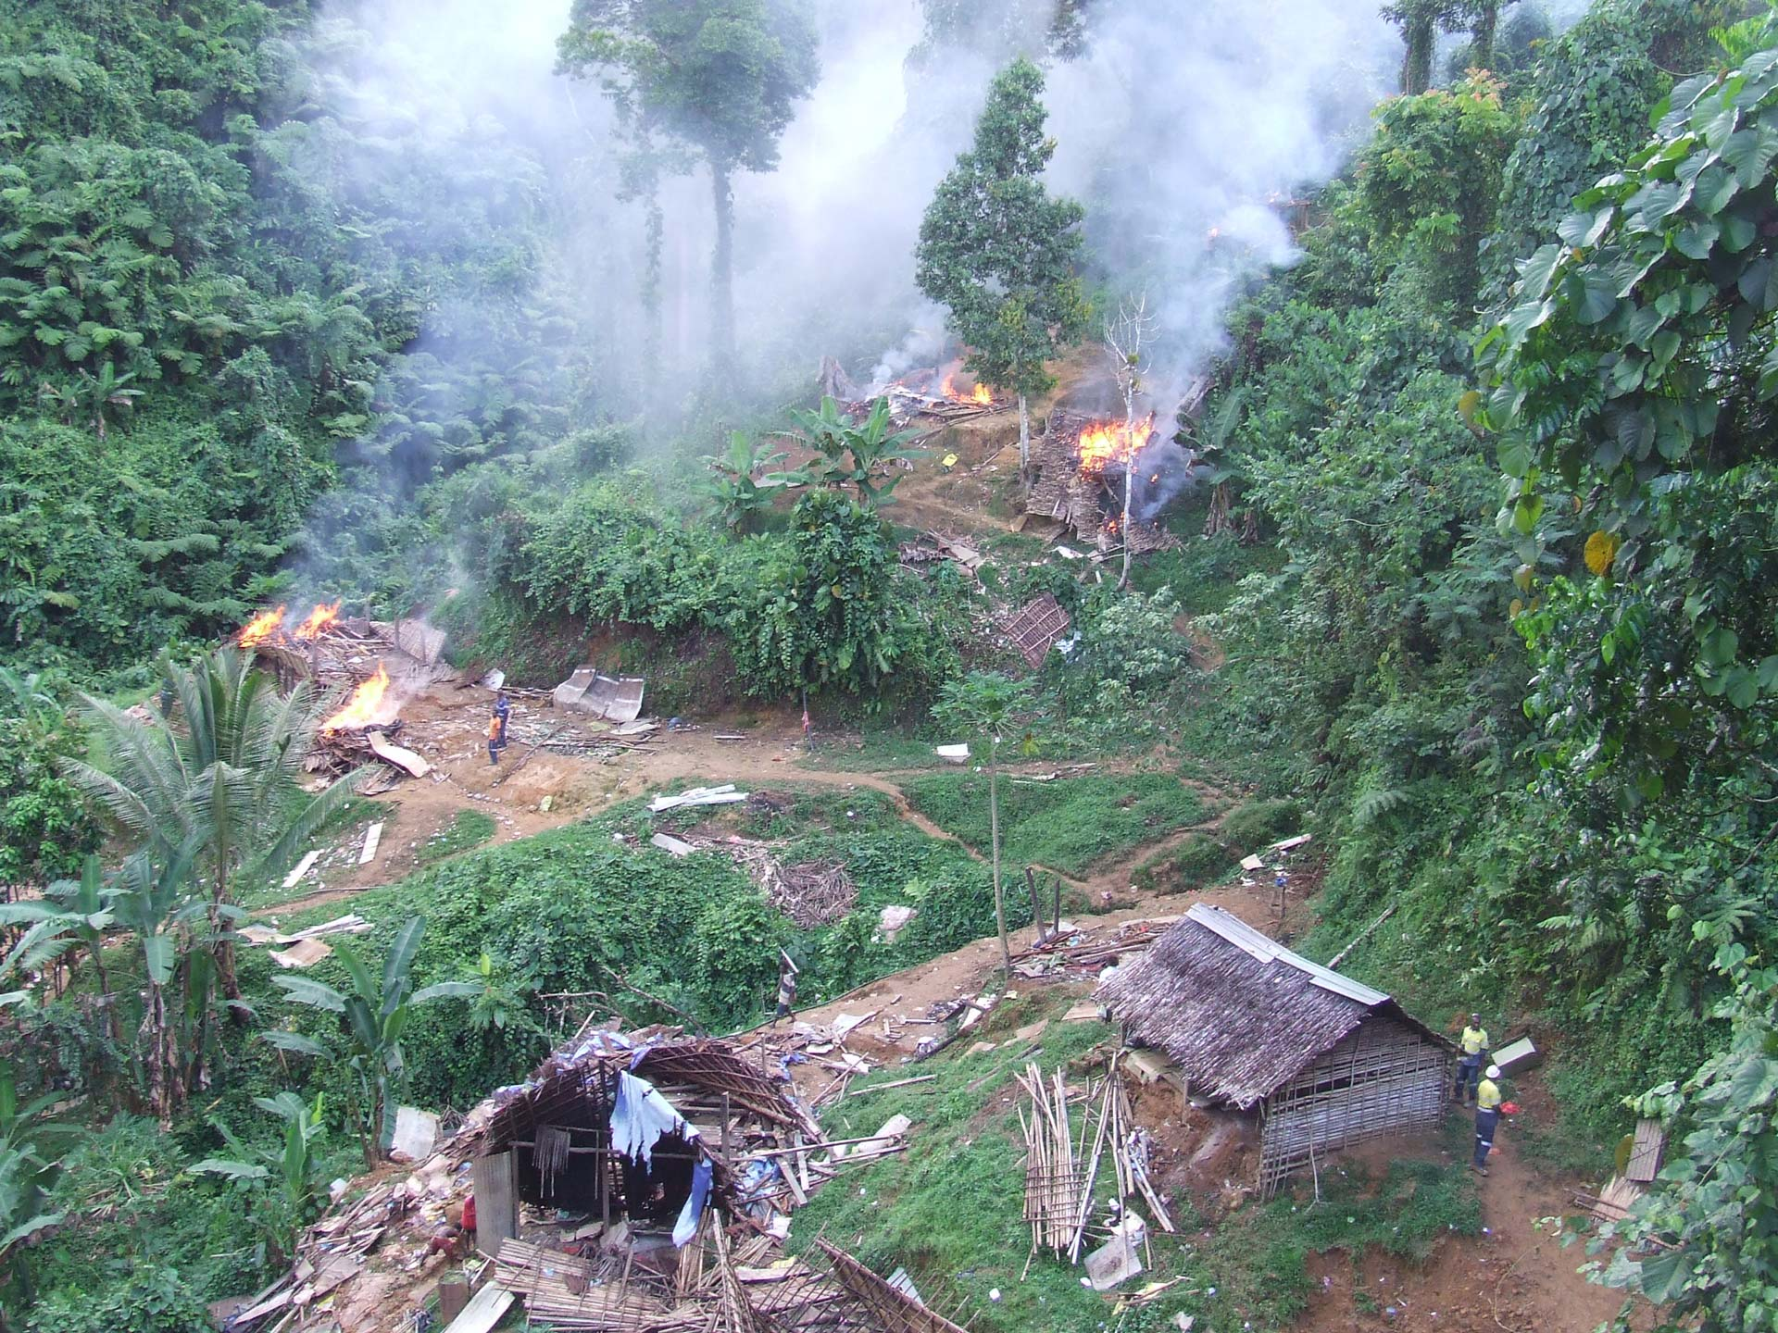
INTRODUCTION

Slide 4
Introduction
Aims and approach
The primary aim is to understand the mechanisms and instruments that governments are using to manage resettlement risks in the mining sector.
The study authors compare legally binding instruments (rules and regulations) related to mining induced displacement and resettlement (MIDR) across six mining jurisdictions.
Report (PDF) can be accessed via this link.

Slide 5
Introduction
Rationale
The scope of laws and regulations, as they relate to MIDR, varies across jurisdictions.
There is evidence of a global trend towards improving national level standards on MIDR.
Monitoring these developments is important as international financial institutions (IFIs) are actively promoting improved regulatory frameworks.
Notes:
In jurisdictions with considerable gaps between the national law and international safeguards, little clarity is provided about what is expected of companies undertaking resettlement activities.

Slide 6
Introduction
Methodology
The comparative review focuses on six mature mining jurisdictions:
Botswana;
Chile;
Côte d’Ivoire;
Ghana;
Papua New Guinea (PNG); and
Peru.
Notes:
The comparative review was informed by the following research questions:
- To what extent are international safeguards present or absent across six case studies?
- What are the most significant gaps between legal and regulatory frameworks and prevailing international norms?
- What lessons can be learnt for mining companies operating in country contexts where international safeguard policies and national legislation do not align?

Slide 7
Introduction
Methodology (continued)
Content analysis was used to assess legislative and regulatory provisions in each country.
More than one-hundred laws, regulations and policies were scrutinised (they can be accessed via this link).
Key requirements stated in the international standards for planned resettlement served as the basis for the selection of themes for comparative analysis.
Notes:
The study process included:
- scoping and sourcing relevant legislation and regulation;
- drawing out relevant legal and regulatory provisions and organising these thematically in tables;
- comparatively analysing relevant provisions across six case studies; and
- writing up the findings to be included in the report.

Slide 8
Introduction
Methodology (continued)
Themes selected for comparative analysis:
01 requirements for compensation;
02 requirements for resettlement;
03 approach to livelihoods;
04 approach to human rights and vulnerable groups;
05 requirements for public participation, stakeholder consultation and information disclosure;
06 planning, compliance, reporting, monitoring and supervision requirements;
07 dispute resolution and other grievance mechanisms;
08 relationship of mining- induced resettlement to approvals/permitting process; and
09 roles and responsibilities of major actors in the event of resettlement.

Slide 9
Land tenure systems and national frameworks

Slide 10
Land tenure systems and national frameworks
Land tenure, land rights and eminent domain
All of the case study countries have constitutional provisions to guide the government in taking land for public interest purposes, including development projects, where no viable alternatives exist.
National frameworks
An overview of land tenure systems and national legal and regulatory frameworks in the mining sector, without specific reference to resettlement.
Notes:
Security of tenure is an important matter when considering the legislative foundations of MIDR. Legal protection and liabilities in each jurisdiction are dependent on the category of land tenure held by the people being displaced. In many jurisdictions, lack of clarity on land tenure leads to disputes about the type of land tenure system in question.

Slide 11
Comparative review of national frameworks

Slide 12
Comparative review of national frameworks
01
02
03
04
05
06
07
08
09
Requirements for compensation
For each of the jurisdictions surveyed, the landholder is entitled to compensation for losses suffered when the government acquires land for public use.
The type of land rights held by citizens determine how land is acquired and the level of compensation made by the government (see notes for further detail)
In Botswana, Chile, Côte d’Ivoire, PNG and Peru, compensation is primarily based on the agreed or fair market value (FMV) of the land at the time of the acquisition.
Ghana has established alternative approaches to calculating compensation, which can be applied in cases where land markets are weak or non-existent.
Notes:
- Where land is acquired from private owners, compensation is given to the owner for ownership interests in the land along with other elements prescribed by law.
- The compulsory acquisition of land from customary rights holders is less prescriptive: the outcome depends on the investor or government agency negotiating with the community and on the community’s legal awareness and access to knowledge.

Slide 13
Comparative review of national frameworks
01
02
03
04
05
06
07
08
09
Requirements for compensation (continued)
Laws in Botswana, Côte d’Ivoire, Ghana and PNG allow affected populations to negotiate compensation levels directly with developers.
Laws in Chile and Peru do not provide affected populations with a legal basis for negotiating compensation amounts with resource developers or the state.
Ghana is the only surveyed country that has laws that provide affected populations with a right to opt for alternative land instead of, or in addition to, compensation.
In other countries, compensation must be paid in cash and once paid the process of compensation is considered to be complete.
In all surveyed countries, informal occupants are not entitled to compensation for the expropriated land.
Notes:
In Botswana, Côte d’Ivoire, Ghana and PNG, affected populations do not necessarily have the final say regarding compensation amounts, but are granted the right to enter into negotiations with developers, submit claims for compensation and/or reach an agreement on compensation amounts.

Slide 14
Comparative review of national frameworks
01
02
03
04
05
06
07
08
09
Requirements for resettlement
None of the surveyed countries have a national resettlement policy or a law to guide project-induced resettlement. PNG has a draft policy framework.
Ghana is the only country surveyed that has regulations specifically related to resettlement in the mining sector.
In all countries, with the exclusion of Ghana:
mining regimes do not regulate the processes of resettlement and relocation in a clear and specific manner;
the law is silent on whether resettlement is a measure of last resort; and
there are no legal provisions to monitor or evaluate resettlement.
Notes:
PNG’s draft framework is comprehensive but there is uncertainty over when the policy framework will be approved or whether all of the proposed elements will be incorporated into legislation once finalised.
Ghana’s regulations were developed to standardise resettlement, to ensure socio-economic and cultural factors are considered, and to guarantee a better quality of life for affected populations.

Slide 15
Comparative review of national frameworks
01
02
03
04
05
06
07
08
09
Approach to livelihoods
Ghana is the only surveyed country in which laws and regulations address livelihood restoration. Legislation requires that displaced people are resettled to suitable alternative land and that their livelihoods and living standards are improved.
Legal and regulatory instruments in other surveyed countries do not have a legal or regulatory requirement for livelihood restoration and do not prescribe measures of ‘full replacement cost’ or ‘standard of living’.

Slide 16
Comparative review of national frameworks
01
02
03
04
05
06
07
08
09
Approach to human rights and vulnerable groups
In Chile and Peru, the ILO Convention 169 requires free, prior and informed consent (FPIC) in cases involving the relocation of Indigenous and tribal peoples.
In other surveyed countries, legal and regulatory systems do not provide for any form of special assistance for vulnerable groups affected by mining projects.
Formal systems mainly favour project affected persons with legal titles to land over those without recognisable legal right or claim.
The legal frameworks of Botswana, Chile, Côte d’Ivoire, Ghana and Peru do not grant communities with unregistered customary tenure the right to obtain compensation when their land is expropriated.
Notes:
Chile and Peru have signed and ratified the ILO Convention 169 (Indigenous and Tribal Peoples Convention). Botswana, Côte d’Ivoire, Ghana and Papua New Guinea have not signed or ratified the convention.
In PNG, laws provide compensation for community tenure rights regardless of whether those rights are formally registered or not.
In Botswana, Chile, Côte d’Ivoire, Ghana and Peru registration of customary tenure rights is a prerequisite to obtaining compensation.

Slide 17
Comparative review of national frameworks
01
02
03
04
05
06
07
08
09
Public participation, consultation and information disclosure
With the exception of Ghana, there are no legal mechanisms requiring proponents to consult with affected communities or to discuss resettlement alternatives.
Legal provisions in Chile and Peru require proponents to consult with Indigenous peoples on significant project impacts.
Ghana’s legislation recommends the fair representation of all key stakeholders in negotiations for compensation and resettlement. There is no legal provision for communities to reject compensation and the request for resettlement.
Notes:
It is assumed that in Chile and Peru resettlement would qualify as a significant impact.
The norms governing Ghana’s legislation and regulations presuppose that the communities ought to accept compensation and resettlement as part of “redistribution” to correct the preeminent environmental burdens imposed by mining.

Slide 18
Comparative review of national frameworks
01
02
03
04
05
06
07
08
09
Planning, monitoring and oversight
In all surveyed countries, with the exception of Ghana, national laws and regulations do not make specific provisions for resettlement action planning and resettlement support, or for monitoring of resettlement activities.
In Ghana, the mining lease holder is responsible for meeting obligations imposed in the Resettlement Action Plan (RAP). Legislation requires that a RAP has to be approved by the district planning authority and then by the Mining Minister.
In all other countries, legislation does not provide for monitoring of the affected peoples after compensation/resettlement. Once compensation has been paid, affected peoples are free to manage their resources as they see fit.
Notes:
Ghana’s regulation limits deadlines for mineral rights holders to draft resettlement and compensation plans to sixty days to ensure “prompt and adequate” compensation. Where the operations of a mining lease holder involve displacement of inhabitants, a Resettlement Monitoring Committee (RMC) is established to assist the Minister in effective monitoring of the implementation of the RAP.
In all other countries there are no legal requirements for follow-up on the impacts of resettlement once compensation has been paid.

Slide 19
Comparative review of national frameworks
01
02
03
04
05
06
07
08
09
Dispute resolution and grievance mechanisms
All case study countries have a formally constituted system to settle disputes that arise during the compensation process.
Formal dispute resolution systems mainly favour project affected peoples with legal titles to land over those without legal title.
Surveyed countries do not have legal or regulatory provisions which require project proponents to establish grievance mechanisms dedicated specifically to address or investigate resettlement issues.
Notes:
If affected persons disagree with the government’s final decision, they are afforded the right to appeal the compensation decision in court, before a tribunal or with the competent authority.
None of the legal systems in the countries surveyed require developers to establish their own grievance mechanism to resolve disputes about compensation agreements.

Slide 20
Comparative review of national frameworks
01
02
03
04
05
06
07
08
09
Mining-induced resettlement and approvals/permitting process
Among surveyed countries, only Ghana’s national framework has identified the need for additional resettlement planning approvals post the initial permitting process.
In other countries, there are no legal requirements for resettlement planning.
In Chile and PNG, limited planning takes place with the state during the early stages of project, and only as part of the initial approvals/permitting processes.
Notes:
In Ghana, a RAP, the primary planning document used to define and manage a resettlement process, is developed alongside an ESIA and linked to the mining contract.

Slide 21
Comparative review of national frameworks
01
02
03
04
05
06
07
08
09
Roles and responsibilities of major actors
All of the jurisdictions surveyed operate in a context where companies lead and finance the projects.
In all surveyed countries, sub-surface rights take precedence over surface rights. It is the responsibility of the sub-surface rights owner to negotiate rights to access the property with the surface landowners.
If resettlement is the agreed option, in all surveyed countries other than Ghana, the lack of laws and regulations implies that no state agencies are charged with managing resettlement.
Notes:
In Ghana, the state delegates responsibility for managing resettlement to mining companies as a permitting condition. The state then appoints members of the RMC, which assists the Minister for Mines in effective monitoring of the implementation of the RAP. The Minerals Commission is responsible for overseeing the formulation and implementation of RAPs with resettlement units established for each project. Mining companies have the responsibility for RAP formulation and implementation, and for funding the resettlement process.
Rights to access the property with the surface landowners can entail anything from surface rent arrangements and land acquisition to compensation and, in some cases, the resettlement of occupants.

Slide 22
KEY FINDINGS

Slide 23
Key findings
01
02
03
04
05
06
07
National frameworks do not align with prevailing international “soft law” instruments.
The implications of this legal and regulatory “gap” are that the different components of resettlement planning are neglected, which can adversely affect communities displaced by mining activities.
Notes:
This findings suggests that efforts to use national level legislation as proxies for international standard may be premature.

Slide 24
Key findings
01
02
03
04
05
06
07
The existing international standards have been unevenly incorporated into national regulatory frameworks.
Ghana’s legal and regulatory framework for MIDR is closest in content to the minimum requirements outlined in IFC Performance Standard 5 – Land Acquisition and Involuntary Resettlement.
Notes:
In other countries surveyed, the following items were not clearly addressed in the relevant laws and regulatory mechanisms:
- how affected people may gain benefits and assert rights under the law with respect to compensation, resettlement and livelihoods restoration;
- the empowerment of government agencies to execute, regulate, and monitor land acquisition and resettlement;
- the processes and institutions of participation and consultation; and
- the assessment, decision making, timing and appeals on matters related to compensation and resettlement.

Slide 25
Key findings
01
02
03
04
05
06
07
Government decisions to expropriate land are often justified on the grounds of public interest.
Under such circumstances, in all surveyed countries with the exception of Ghana, there is no clear obligation for governments to resettle affected persons in a manner that is consistent with the principles outlined in the international safeguard standards and policies.

Slide 26
Key findings
01
02
03
04
05
06
07
National frameworks bias landowners over land users (i.e. occupants).
The case study examples suggest that mining legislation is typically weak in terms of its ability to recognise communal land rights or to handle resettlement and compensation activities in those environments.
Notes:
In some cases, improvements in the form of structures and crops are compensated, which suggest that land users’ rights are recognised.

Slide 27
Key findings
01
02
03
04
05
06
07
The effect of FPIC laws on engagement and consultation processes in Chile and Peru.
In both countries, the right to consultation is legally respected even when the affected Indigenous peoples refuse to give their consent. While the goal of the FPIC consultation process is to obtain consent from the Indigenous peoples, the focus of the legislation is to ensure that correct processes of engagement were adhered to.
Notes:
This provision poses a risk in so far that consultations do not need to reach a substantive outcome as long as procedural requirements are met.

Slide 28
Key findings
01
02
03
04
05
06
07
National laws in all surveyed countries mandate community participation in decision-making on mining investments.
Participatory mechanisms often fall short of what is needed to ensure that the voices of vulnerable groups are heard. This is particularly the case in the three African jurisdictions reviewed, where it can be difficult for land users to prove their customary rights to land.

Slide 29
Key findings
01
02
03
04
05
06
07
A major challenge for governments is to ensure fair, prompt and adequate compensation for mining-affected communities’ interests.
The adequacy of the compensation requires careful consideration through agreed-upon negotiation and evaluation methods.
Notes:
If compensation is inadequate in relation to the long-term social and economic costs of mining, this can generate long-term tensions between mining companies, governments and mining-affected communities.

Slide 30
ACKNOWLEDGEMENTS
This study was supported by research funds provided by The University of Queensland’s Vice Chancellor’s strategic fund, core operating funds from the Sustainable Minerals Institute (SMI) and pooled contributions of five mining companies: Anglo American, Newcrest, Newmont, MMG and Rio Tinto.

